Slide 1
Java AWT
Lecture 10

Slide 2
Awt
Abstract Window Toolkit
Graphical User Interface (GUI) offers user interaction via some graphical components.
Components: window,frame,Panel, Button, Textfield, TextArea, Listbox, Combobox, Label, Checkbox etc.
GUI provides result to end user in response to raised events.GUI is entirely based events.

Slide 3
Creating awt
To create simple awt example, you need a frame. There are two ways to create a frame in AWT.
By extending Frame class (inheritance)
By creating the object of Frame class (association)

Slide 4
Extending Frame class
import java.awt.*;
class First extends Frame
{
First()
{
Button b=new Button("click me");
b.setBounds(30,100,80,30);
add(b);
setSize(300,300);
setLayout(null);
setVisible(true);
}
public static void main(String args[])
{
First f=new First();
}
}

Slide 5
Frame class association
import java.awt.*;
class First2
{
First2() {
Frame f=new Frame();
Button b=new Button("click me");
b.setBounds(30,50,80,30);
f.add(b);
f.setSize(300,300);
f.setLayout(null);
f.setVisible(true);
}
public static void main(String args[])
{
First2 f=new First2();
}
}

Slide 6
awt controls
AWT supports following types of controls:
Labels
Push Buttons
Check Boxes
Choice List
Lists
scroll bars
text editing

Slide 7
Adding and removing control
add() method is used to add a control to a window.
component add(component obj);
remove() is used to remove a control from the window.
void remove(Component obj);

Slide 8
labels
a label is an object of type Label and it contains a string which it displays.
They do not support any interaction with the user.
Constructor:
Label()
Label(String str)
Label(String str, Int how)
how must be one of these constants : Label.LEFT, Label.RIGHT, Label.CENTER.
setText() method is used to change or set the Text of Label.
getText() method is used to get the current label.
setAlignment(int how)
getAlignment()

Slide 9
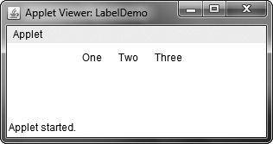
Example
import java.awt.*;
import java.applet.*;
public class LabelDemo extends Applet {
public void init() {
Label one = new Label("One");
Label two = new Label("Two");
Label three = new Label("Three");
add(one);
add(two);
add(three);
}
}

Slide 10
Buttons
A push button is a component that contains a label and that generates an event when it is pressed.
Button defines these two constructors:
Button( )
Button(String str)
setLabel() is used to set the label of the button
getLabel() is used to retrieve the button label.
void setLabel(String str)
String getLabel( )

Slide 11
handling button
Each time a button is pressed, an action event is generated. This is sent to any listeners.
Each listener implements the ActionListener interface. That interface defines the actionPerformed( ) method, which is called when an event occurs.
An ActionEvent object is supplied as the argument to this method.

Slide 12
Example
import java.awt.*;
import java.awt.event.*;
import java.applet.*;
public class ButtonDemo extends Applet implements ActionListener {
String msg = “” ;
Button yes, no, maybe;
public void init()
{
yes = new Button("Yes");
no = new Button("No");
maybe = new Button("Undecided");
add(yes);
add(no);
add(maybe);
yes.addActionListener(this);
no.addActionListener(this);
maybe.addActionListener(this);
}

Slide 13
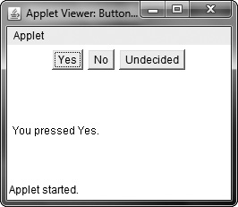
public void actionPerformed(ActionEvent ae)
{
String str = ae.getActionCommand();
if(str.equals("Yes"))
{
msg = "You pressed Yes.";
}
else if(str.equals("No"))
{
msg = "You pressed No.";
}
else
{
msg = "You pressed Undecided.";
}
repaint();
}
public void paint(Graphics g) {
g.drawString(msg, 6, 100);
}
}

Slide 14
Check Boxes
A check box is a control that is used to turn an option on or off.
Check boxes can be used individually or as part of a group
Checkbox supports these constructors:
Checkbox( )
Checkbox(String str)
Checkbox(String str, boolean on)
Checkbox(String str, boolean on, CheckboxGroup cbGroup)
Checkbox(String str, CheckboxGroup cbGroup, boolean on)
getState( ) is used to determine the current state of check box
setState() is used to set the current state
getLabel() and setLabel() are used to retrieve and set the label of the checkbox.

Slide 15
handling Checkbox
Each time a check box is selected or deselected, an item event is generated.
This is sent to any listeners.
Each listener implements the ItemListener interface.
That interface defines the itemStateChanged( ) method. An ItemEvent object is supplied as the argument to this method.

Slide 16
public class CheckboxDemo extends Applet implements ItemListener {
String msg = "";
Checkbox windows, android, solaris, mac;
public void init() {
windows = new Checkbox("Windows", null, true);
android = new Checkbox("Android");
solaris = new Checkbox("Solaris");
mac = new Checkbox("Mac OS");
add(windows);
add(android);
add(solaris);
add(mac);
windows.addItemListener(this);
android.addItemListener(this);
solaris.addItemListener(this);
mac.addItemListener(this);
}

Slide 17
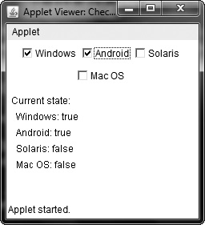
public void itemStateChanged(ItemEvent ie) {
repaint();
}
// Display current state of the check boxes.
public void paint(Graphics g) {
msg = "Current state: ";
g.drawString(msg, 6, 80);
msg = " Windows: " + windows.getState();
g.drawString(msg, 6, 100);
msg = " Android: " + android.getState();
g.drawString(msg, 6, 120);
msg = " Solaris: " + solaris.getState();
g.drawString(msg, 6, 140);
msg = " Mac OS: " + mac.getState();
g.drawString(msg, 6, 160);
}
}

Slide 18
Check Box group
It is possible to create a set of mutually exclusive check boxes in which one and only one check box in the group can be checked at any one time.
These check boxes are often called radio buttons.
Check box groups are objects of type CheckboxGroup. Only default constructor is allowed.
getSelectedCheckbox( ) to determine which checkbox is selected.
setSelectedCheckbox( ) to set a checkbox selected.

Slide 19
public class CBGroup extends Applet implements ItemListener {
String msg = "";
Checkbox windows, android, solaris, mac;
CheckboxGroup cbg;
public void init() {
cbg = new CheckboxGroup();
windows = new Checkbox("Windows", cbg, true);
android = new Checkbox("Android", cbg, false);
solaris = new Checkbox("Solaris", cbg, false);
mac = new Checkbox("Mac OS", cbg, false);
add(windows);
add(android);
add(solaris);
add(mac);
windows.addItemListener(this);
android.addItemListener(this);
solaris.addItemListener(this);
mac.addItemListener(this);
}

Slide 20
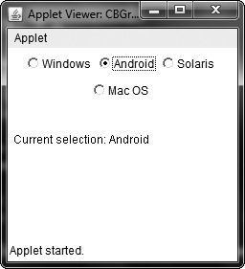
public void itemStateChanged(ItemEvent ie) {
repaint();
}
// Display current state of the check boxes.
public void paint(Graphics g) {
msg = "Current selection: ";
msg += cbg.getSelectedCheckbox().getLabel();
g.drawString(msg, 6, 100);
}
}

Slide 21
CHOICE CONTROLS
The Choice class is used to create a pop-up list of items from which the user may choose.
To add a selection to the list, call add( ).
The getSelectedItem( ) method returns a string containing the name of the item.
getSelectedIndex( ) returns the index of the item. The first item is at index 0.
By default, the first item added to the list is selected.
To obtain the number of items in the list, call getItemCount( ).

Slide 22
public class ChoiceDemo extends Applet implements ItemListener {
Choice os, browser;
String msg = "";
public void init() {
os = new Choice();
browser = new Choice();
os.add("Windows");
os.add("Android");
os.add("Solaris");
os.add("Mac OS");
browser.add("Internet Explorer");
browser.add("Firefox");
browser.add("Chrome");
add(os);
add(browser);
os.addItemListener(this);
browser.addItemListener(this);
}

Slide 23
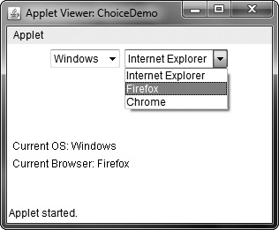
public void itemStateChanged(ItemEvent ie) {
repaint();
}
public void paint(Graphics g) {
msg = "Current OS: ";
msg += os.getSelectedItem();
g.drawString(msg, 6, 120);
msg = "Current Browser: ";
msg += browser.getSelectedItem();
g.drawString(msg, 6, 140);
}
}

Slide 24
List
public class ListDemo extends Applet implements ActionListener {
List os, browser;
String msg = "";
public void init() {
os = new List(4, true);
browser = new List(4, false);
os.add("Windows");
os.add("Android");
os.add("Solaris");
os.add("Mac OS");
browser.add("Internet Explorer");
browser.add("Firefox");
browser.add("Chrome");
browser.select(1);
add(os);
add(browser);
browser.addActionListener(this);
}

Slide 25
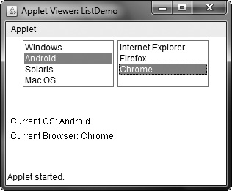
public void actionPerformed(ActionEvent ae)
{
repaint();
}
public void paint(Graphics g)
{
int idx[];
msg = "Current OS: ";
idx = os.getSelectedIndexes();
for(int i=0; i<idx.length; i++)
msg += os.getItem(idx[i]) + " ";
g.drawString(msg, 6, 120);
msg = "Current Browser: ";
msg += browser.getSelectedItem();
g.drawString(msg, 6, 140);
}
}

Slide 26
Layout managers
Each Container object has a layout manager associated with it.
A layout manager is an instance of any class that implements the LayoutManager interface.
The layout manager is set by the setLayout( ) method. If no call to setLayout( ) is made, then the default layout manager is used.
If you wish to disable the layout manager and position components manually, pass null. Determine the shape and position of each component manually using setBounds() method.
Whenever a container is resized (or sized for the first time), the layout manager is used to position each of the components within it.

Slide 27
TYPES
Flow layout
Border
using inset
Grid LAYOUT
Card layout
Grid Bag layout

Slide 28
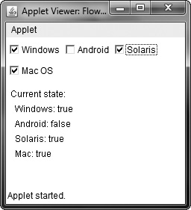
FLOW LAYOUT
Flow Layout: This is default layout.
the constructors for FlowLayout:
FlowLayout( )
FlowLayout(int how)
FlowLayout(int how, int horz, int vert)
FlowLayout.LEFT
FlowLayout.CENTER
FlowLayout.RIGHT
FlowLayout.LEADING
FlowLayout.TRAILING

Slide 29
Border layout
The BorderLayout class implements a common layout style for top-level windows.
It has four narrow, fixed-width components at the edges and one large area in the center.
The four sides are referred to as north, south, east, and west. The middle area is called the center.
the constructors defined by BorderLayout:
BorderLayout( )
BorderLayout(int horz, int vert)

Slide 30
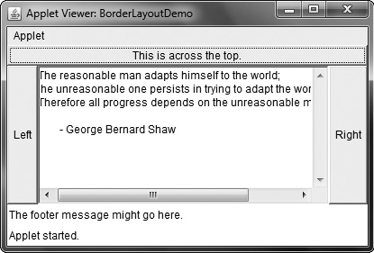
public class BorderLayoutDemo extends Applet {
public void init() {
setLayout(new BorderLayout());
add(new Button("This is across the top."),
BorderLayout.NORTH);
add(new Label("The footer message might go here."),
BorderLayout.SOUTH);
add(new Button("Right"), BorderLayout.EAST);
add(new Button("Left"), BorderLayout.WEST);
String msg = "The reasonable man adapts " +
"himself to the world;\n" +
"the unreasonable one persists in " +
"trying to adapt the world to himself.\n" +
"Therefore all progress depends " +
"on the unreasonable man.\n\n" +
" - George Bernard Shaw\n\n";
add(new TextArea(msg), BorderLayout.CENTER);
}
}

Slide 31
USING INSET
Sometimes you will want to leave a small amount of space between the container that holds your components and the window that contains it.
The constructor for Insets is shown here:
Insets(int top, int left, int bottom, int right)
To do this, override the getInsets( ) method that is defined by Container. This method returns an Insets object that contains the top, bottom, left, and right inset to be used when the container is displayed.

Slide 32
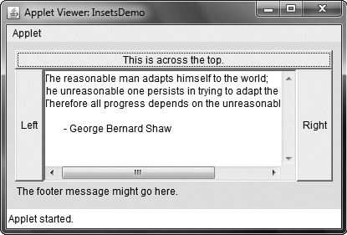
public Insets getInsets() {
return new Insets(10, 10, 10, 10);
}

Slide 33
GRID LAYOUT
GridLayout lays out components in a two-dimensional grid.
Constructors:
GridLayout( )
GridLayout(int numRows, int numColumns)
GridLayout(int numRows, int numColumns, int horz, int vert)

Slide 34
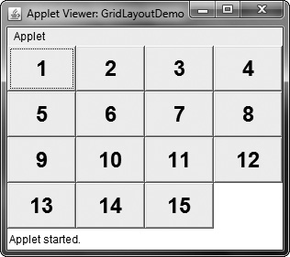
public class GridLayoutDemo extends Applet {
static final int n = 4;
public void init() {
setLayout(new GridLayout(n, n));
setFont(new Font("SansSerif", Font.BOLD, 24));
for(int i = 0; i < n; i++) {
for(int j = 0; j < n; j++) {
int k = i * n + j;
if(k > 0)
add(new Button("" + k));
}
}
}
}

